Slide 1
Oracle Service Cloud Connector
September 2014

Slide 2
Disclaimer
"The information contained herein is provided for information purposes only and is intended only to outline Avaya’s presently anticipated general technology direction. The information is not a commitment or an obligation to deliver any product, product feature or software functionality and Avaya reserves the right to make changes to the content and timing of any product, product feature or software release. Prices for any future product or software included herein will be separately negotiated when and if such product or software becomes available."

Slide 3




Solution Overview
Customer
Incident
Chat
Call
Non-voice interactions
CRM process
Interactions delivery
Calls, Chats & Incidents
Agent

Slide 4
Avaya & Oracle bring powerful value to customers
Main Features | Avaya Call Center Elite | Oracle Service Cloud
CRM Plattform |  | X
Agent Desktop UI |  | X
Contact Context Information(rel1.1) | X | X
Agent State Control (rel1.1) | X
Call Control (rel1.1) | X
Chat Control |  | X
Incident Control |  | X
Call Routing (rel1.1) | X
Chat Routing (rel2.0) | X
Incident Routing (rel2.0) | X
Interaction Reporting (rel2.0) | X | X

Slide 5
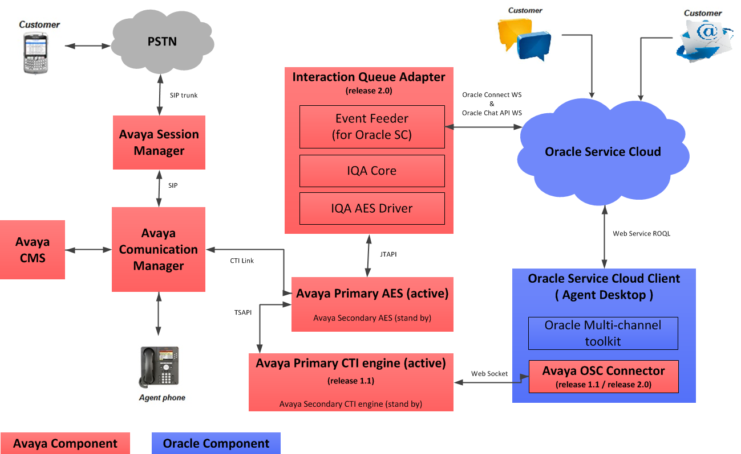
Avaya Oracle SC Connector Architecture

Slide 6
Standard Call / Interaction Flow Sequence in Multi Site Environment
Self Service
Segmentation
Routing/ACD Selection
Agent Assignment (ACD)
Screen Pop-up (Agent)
Voice Call (release 1.1)
Avaya Experience Portal
Avaya
CC Elite
Oracle SC client
Custom OD Apps
ICR Routing
ICR Call Control
Chat & Incident Interaction / non-media call (release 2.0)
Oracle Service Cloud
Avaya IQA
Avaya Experience Portal
ICR Routing
ICR Call Control

Slide 7
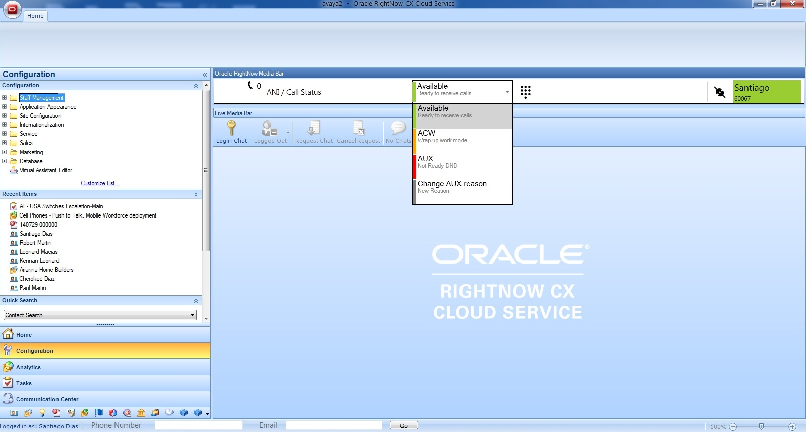
Voice Toolbar Look & Feel

Slide 8
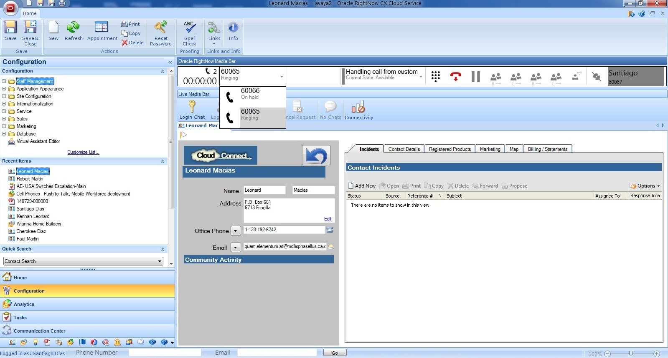
Voice Toolbar Screen Pop Up

Slide 9
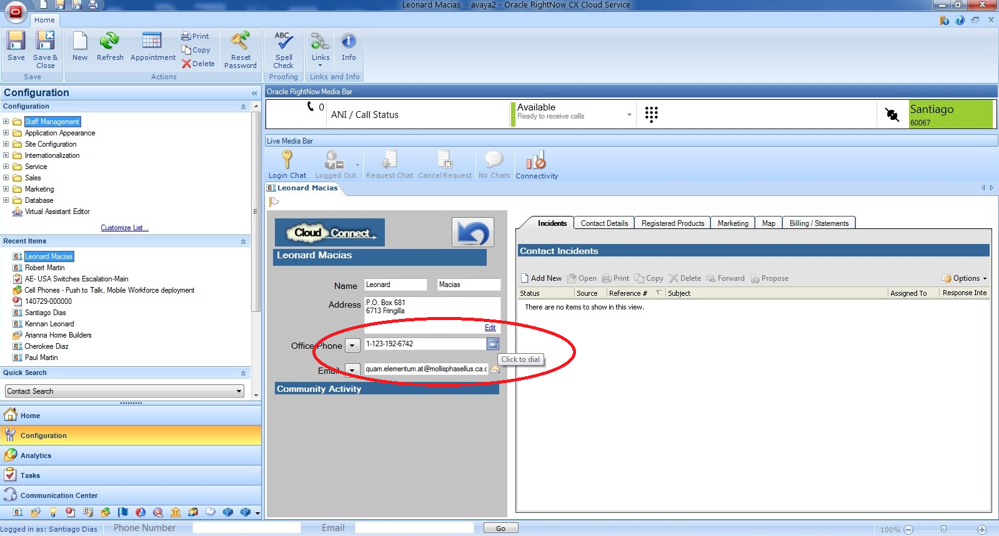
Voice Toolbar Click To Dial

Slide 10
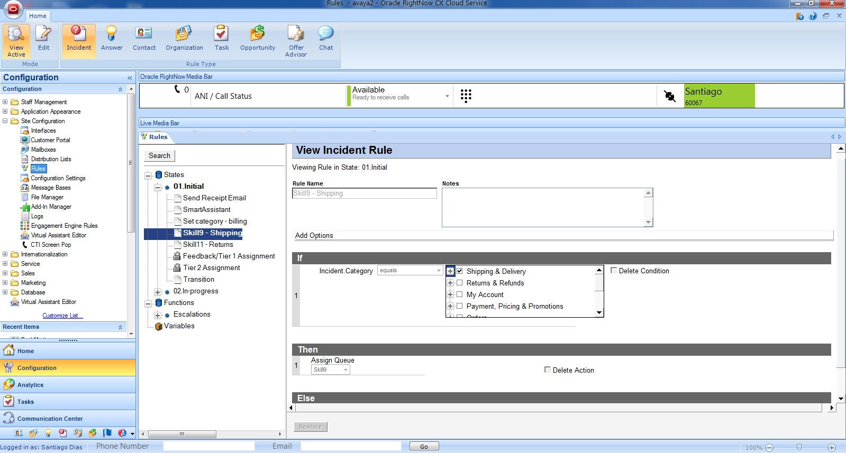
Segmentation & Routing for non media interactions (Chat & Incidents)

Slide 11
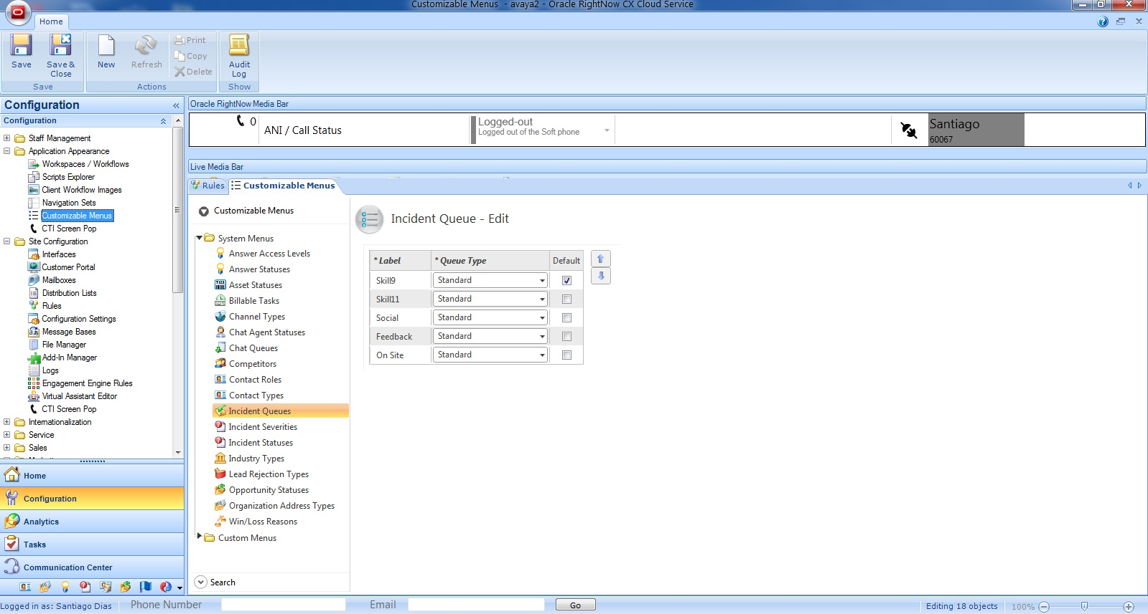
Segmentation & Routing for non media interactions (Chat & Incidents)

Slide 12
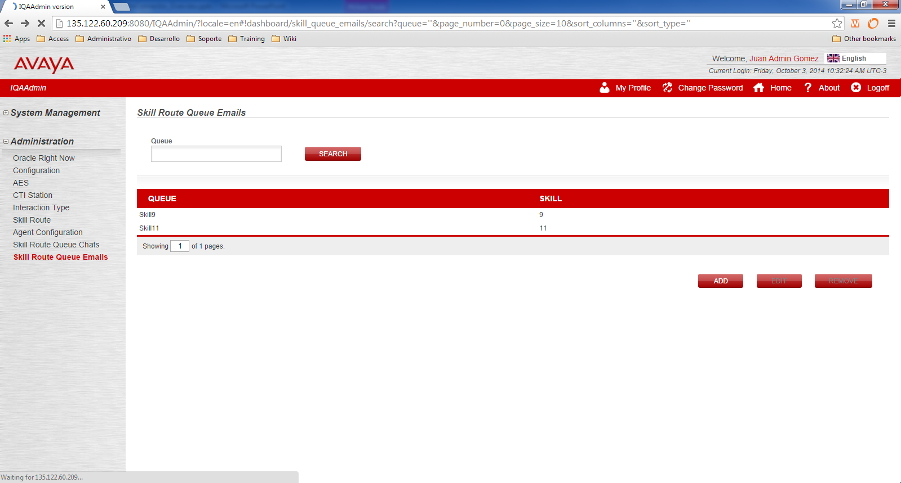
Segmentation & Routing for non media interactions (Chat & Incidents)

Slide 13



